Slide 1
Introduction
to Python
Sin Yan | Sonia

Slide 2
Hello! We are NYP LIT
NYP Ladies in Tech is the newest of the four special interest groups
Our mission is to empower women of our generation

Slide 3
Table of Content
Kahoot Quiz (Recap of Day 1 Materials)
Hangman
1
3
Rock,Paper,Scissors
Snake Game
2
4
4
3

Slide 4
Kahoot Quiz
1
Day 1 Materials Recap Time

Slide 5
Part 1:

Slide 6
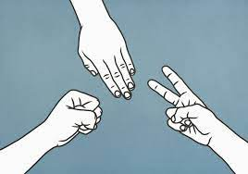
Rock, Paper, Scissors
What is Rock,Paper,Scissors?
a game where each person simultaneously makes one of three hand gestures representing a rock, a sheet of paper, and a pair of scissors respectively.
Each gesture defeats one and is defeated by one of the other two:
rock defeats scissors but is defeated by paper;
paper defeats rock but is defeated by scissors.
The person whose gesture defeats the other is selected.

Slide 7
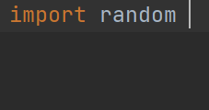
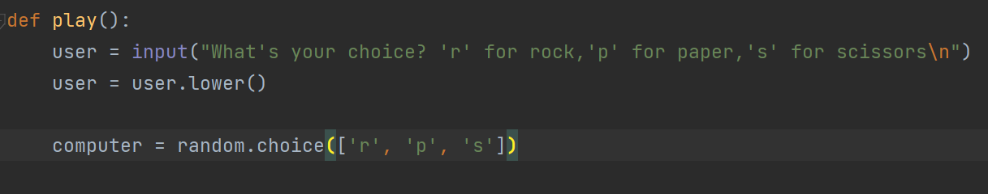
Rock, Paper, Scissors
Import Random
Random is a built-in module in python.
def play():
Define a function called play.

Slide 8
Rock, Paper, Scissors
User | Computer | Result
Rock | Rock | Tie
Rock | Paper | Lose
Rock | Scissors | Win
Paper | Rock | Win
Paper | Paper | Tie
Paper | Scissors | Lose
Scissors | Rock | Lose
Scissors | Paper | Win
Scissors | Scissors | Tie

Slide 9
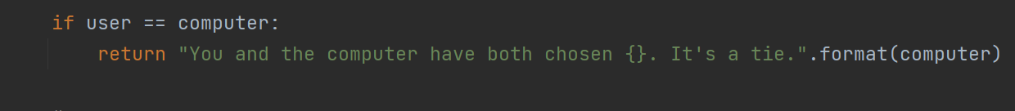
Rock, Paper, Scissors
If user == computer:
Create an if statement where if user is equal to computer. (for example, user = r, computer = r. Therefore user = computer)

Slide 10
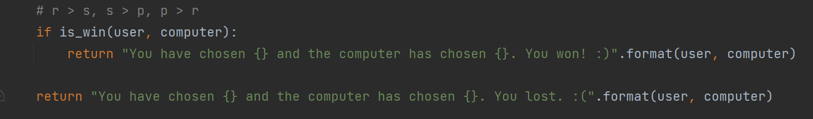
Rock, Paper, Scissors
If is_win(user, computer):
Create an if statement to call a helper function called is_win and passed in user and computer arguments.

Slide 11
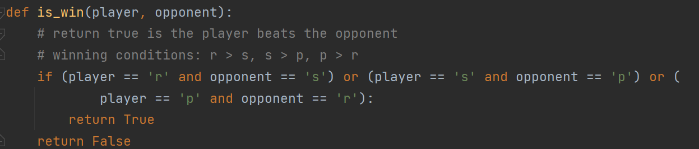
Rock, Paper, Scissors
def is_win():
Define a function called is_win outside of the def play() function.

Slide 12
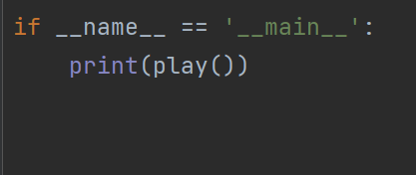
Rock, Paper, Scissors
print(play())
Print the code that calls the play function.

Slide 13
Let’s start coding!

Slide 14
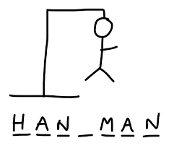
Hangman
What is Hangman?
A word game in which one player has to guess a word that the other player has thought of, by guessing the letters in it.
Every time they guess a wrong letter, part of a picture of a person being hanged is drawn, and if the picture is completed the person guessing has lost.

Slide 15
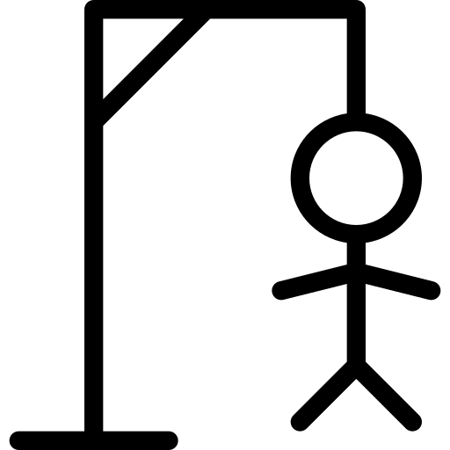
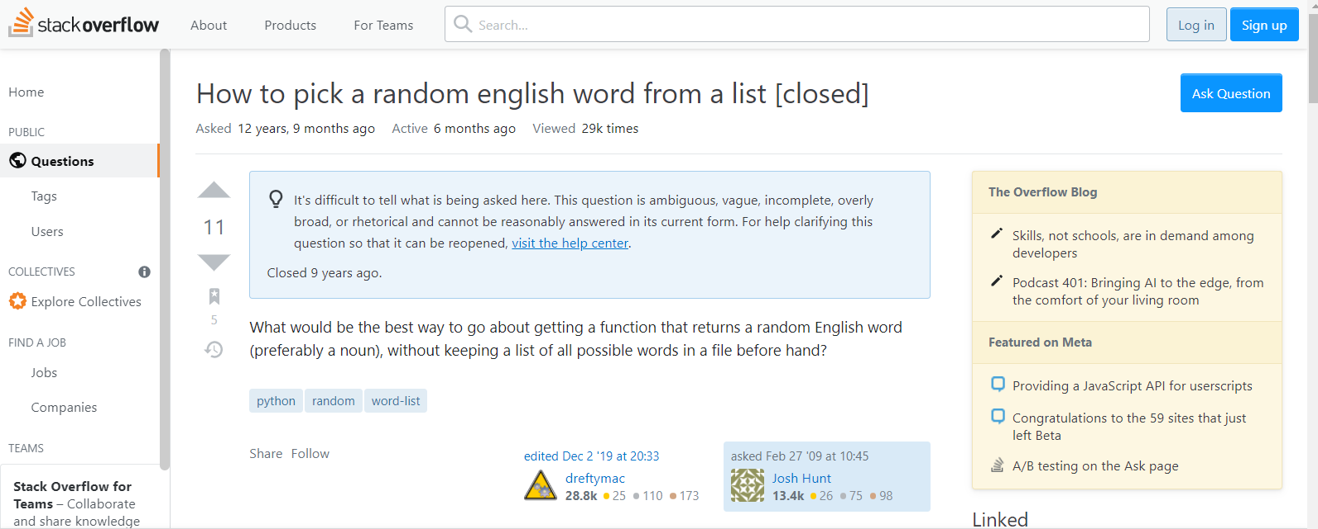
Hangman
Go to this link here
StackOverflow - How to pick a random english word from a list
https://stackoverflow.com/questions/594273/how-to-pick-a-random-english-word-from-a-list

Slide 16
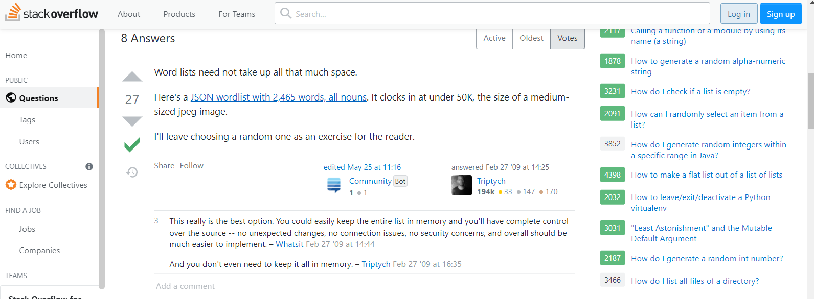
Hangman
StackOverflow
Scroll down the post to the first answer, click on the hyperlink in blue. Copy everything in the webpage.

Slide 17
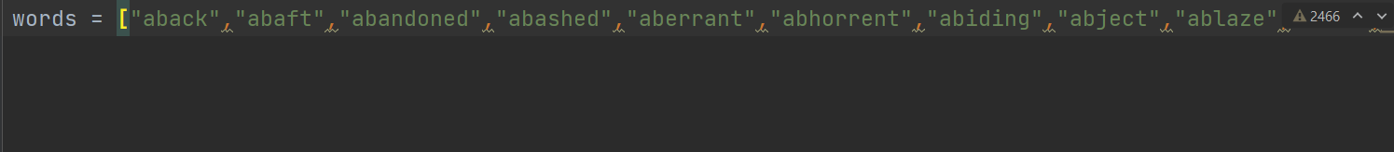
Hangman
Create words.py
Create a python file called words.py. Copy and paste every word in the file in a list.

Slide 18
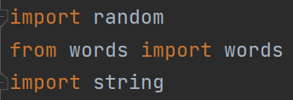
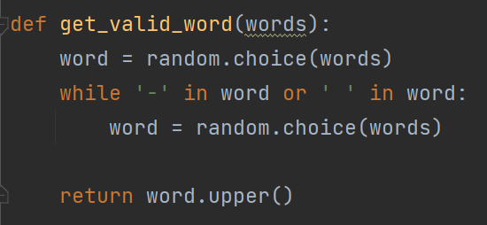
Hangman
Importing respective modules
Import random, words(words.py), string into hangman.py
def get_valid_word():
Create a function called get_valid_word.

Slide 19
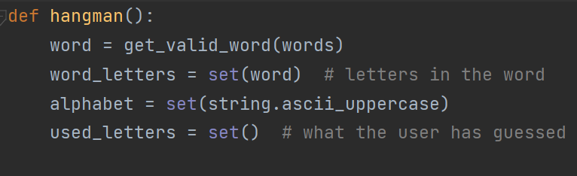
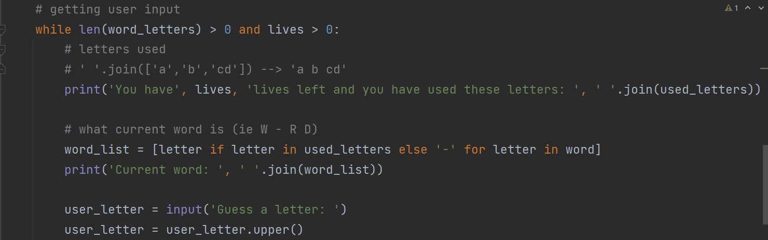
Hangman
def hangman():
Create a function called hangman.
While len(word_letters) > 0 and lives > 0:
While statement for when length of word_letter is greater than 0 and lives >0.

Slide 20
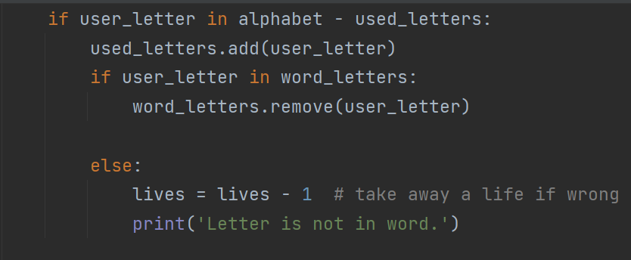
Hangman
if user_letter in alphabet - used_letters:
Create if statement to add letters to used_letters.
if user_letter in word_letters:
Create if statement to remove user_letter from word_letters.

Slide 21
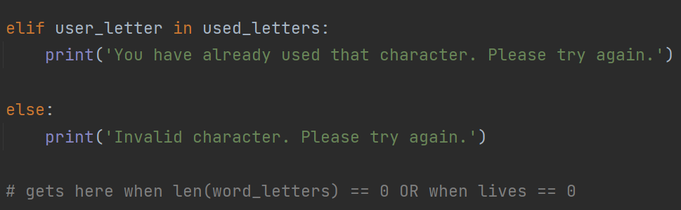
Hangman
elif user_letter in used_letters:
Create elif statement to tell user that user has used a letter.
else:
Create an else statement to tell user that user entered an invalid character.

Slide 22
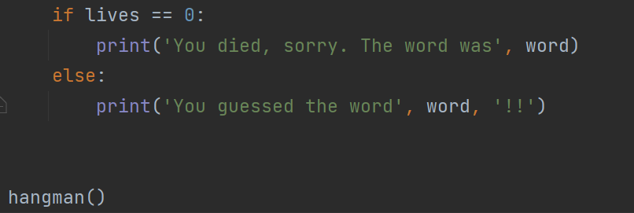
Hangman
If lives == 0:
Create if statement to tell user died as lives are equal to 0.
else:
Create else statement to tell user they have guessed the word.

Slide 23
Let’s start coding!

Slide 24
Part 2:

Slide 25
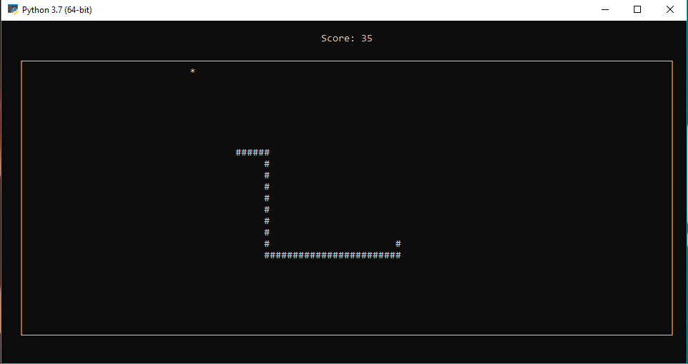
Snake Game
What is Snake game?
Snake is a classic video game from the late 70s.
The basic goal is to navigate a snake and eat as much food as possible without touching the walls or the snake’s body.
The player uses the arrow keys to move a "snake" around the board.
As the snake finds food, it eats the food, and thereby grows larger.
The game ends when the snake either moves off the screen or moves into itself.
The goal is to make the snake as large as possible before that happens.

Slide 26

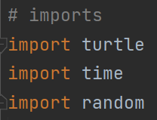
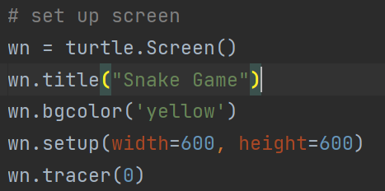
Snake Game
Importing respective modules
Import random, turtles and time into snakegame.py
Setting up the screen
Write these set of codes to set up screen for snakegame.py

Slide 27
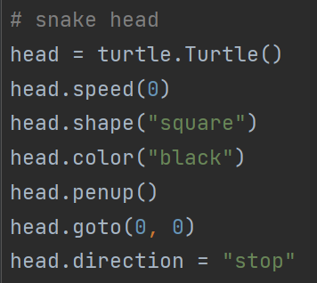
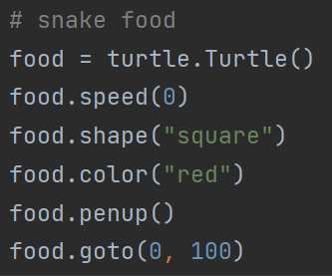
Snake Game
Creating the snake head
Write these set of codes to create the snake head.
Creating the snake food
Write these set of codes to create the snake food.

Slide 28
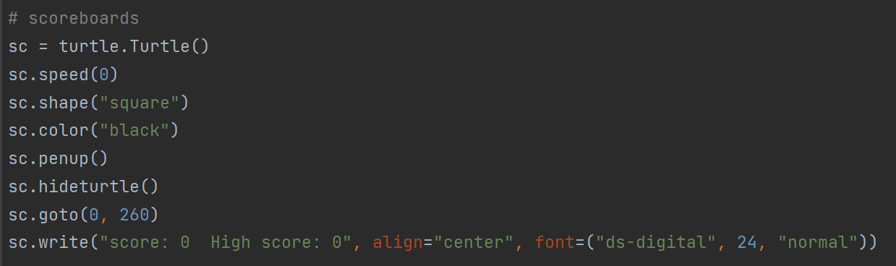
Snake Game
Creating the scoreboard
Write these set of codes to create the scoreboard.

Slide 29
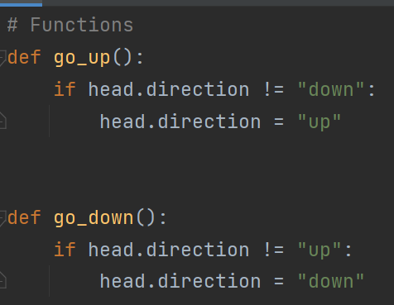
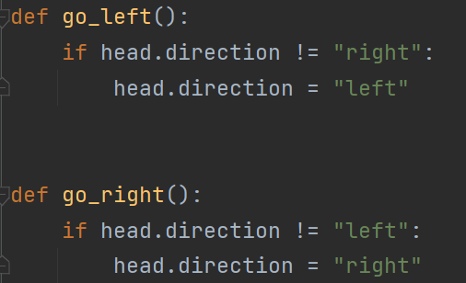
Snake Game
Creating the functions
Create these functions called
go_up, go_down, go_left , go_right.

Slide 30
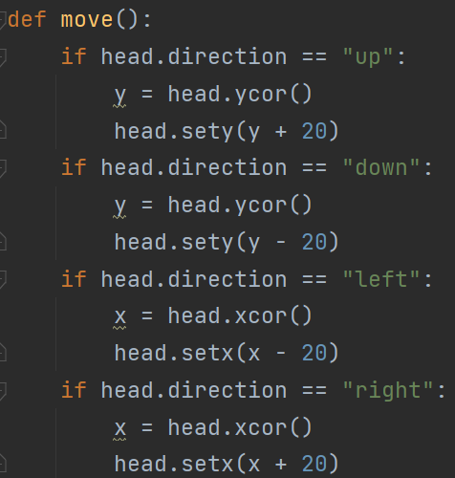
Snake Game
def move()
Create the function called move.

Slide 31
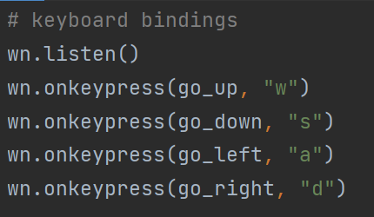
Snake Game
Creating keyboard bindings
Create the keyboard bindings to
move the snake using the wsad keys.

Slide 32
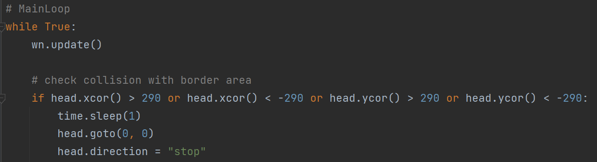
Snake Game
Creating main loop.
Checking collision with border area.
Write these set of codes
to create the main loop.
Write these set of codes to check for collision with border area.

Slide 33
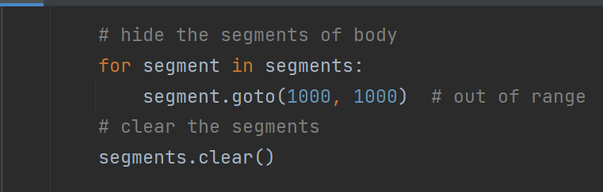
Snake Game
Hiding segments of body
Write these codes to hide the segments of the snake body.
Clearing the segments
Write segments.clear() to clear the segments.

Slide 34
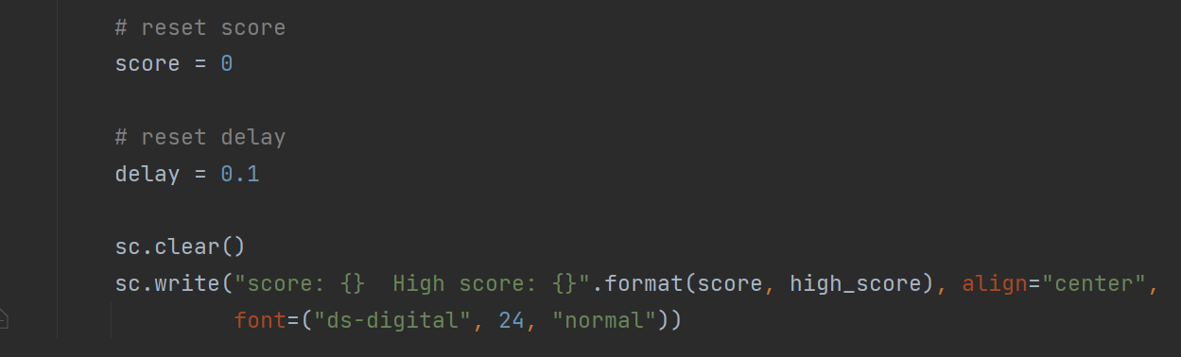
Snake Game
Reset score and delay
Write these codes to reset score and delay.

Slide 35
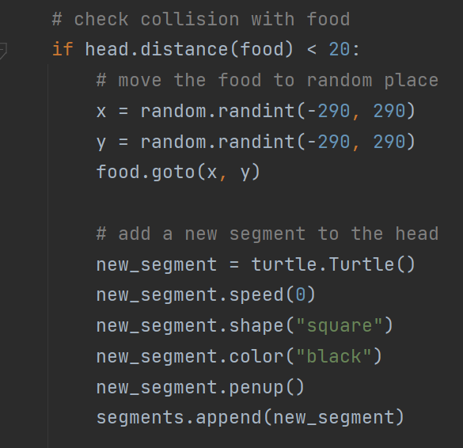
Snake Game
Checking collision with food
Write these set of codes to check for collision with food, move food to a random place and add a new segment to the snake head.

Slide 36
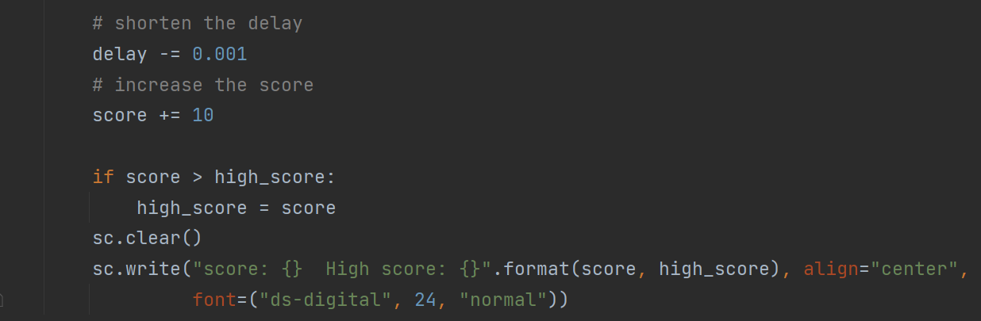
Snake Game
Changing the score and delay time
Write these set of codes to shorten the delay time, increase the score and update the highest score.

Slide 37
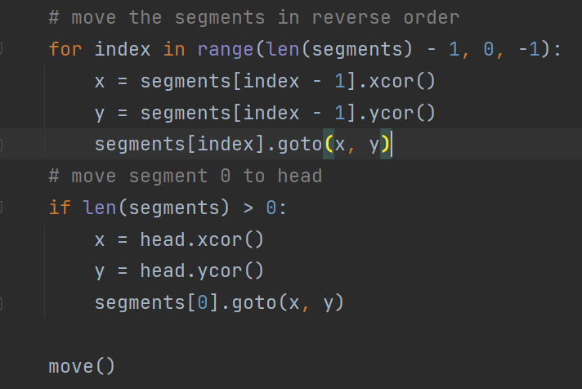
Snake Game
Moving the segments
Write these set of codes to move the segments in reverse order and move segment 0 to the snake head.

Slide 38
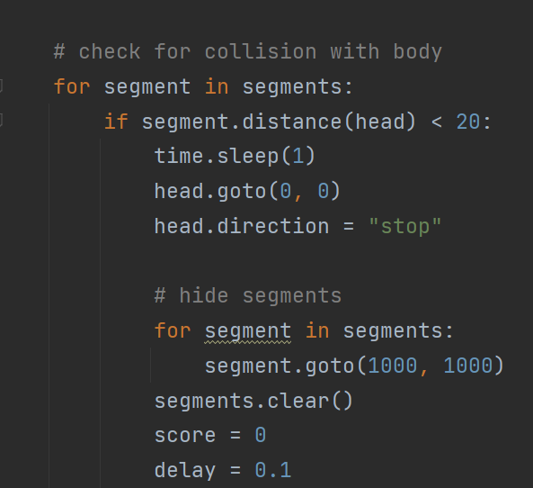
Snake Game
Checking collision with body
Write these set of codes to check for collisions with body and hide segments

Slide 39
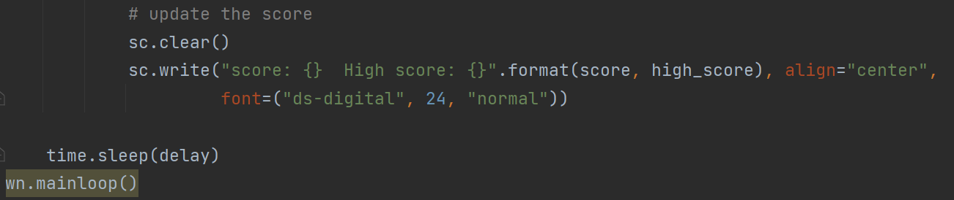
Snake Game
Updating the score
Write these codes to update the scoreboard.

Slide 40
Let’s start coding!

Slide 41
Conclusion
We have covered the following:
Recap of day 1 materials through kahoot
Application of Python programming in 3 games
How to create the rock,paper,scissors game
How to create the hangman game
How to create the snake game

Slide 42

Thank you!
?
Do you have any questions?
Check out our socials or contact us at nyplit@gmail.com
@nyp_lit
https://nyp-lit.github.io/

Slide 43
Credits.
Presentation Template: SlidesMania
Images: Unsplash
Fonts used in this presentation: DM Sans and Lexend Deca

Slide 44
Editable Icons

